Slide 1
LES TRIGGERS

Slide 2
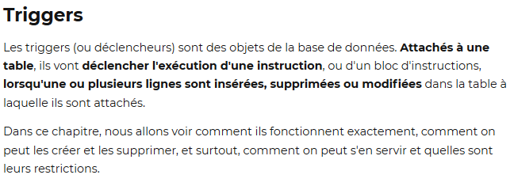

Slide 3
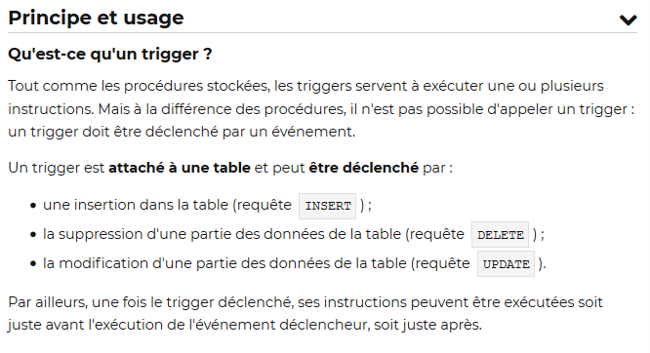

Slide 4
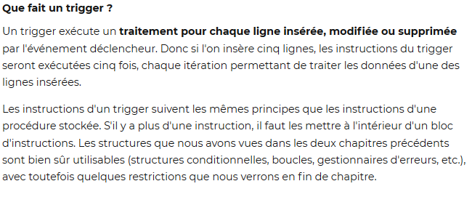

Slide 5
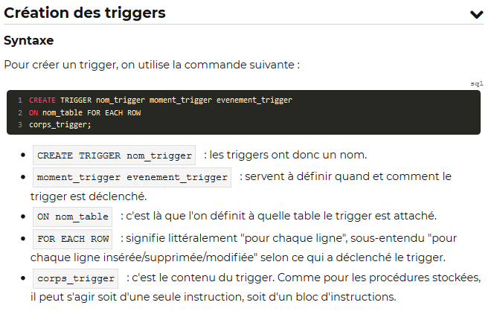

Slide 6
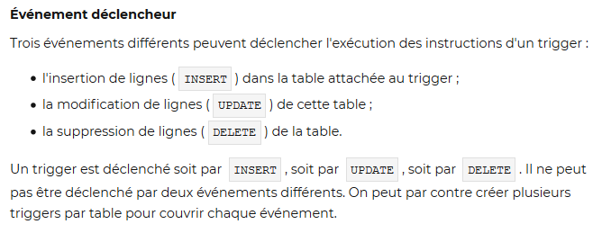

Slide 8
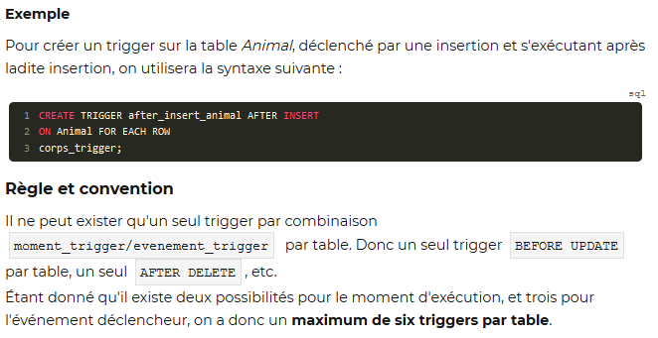

Slide 9
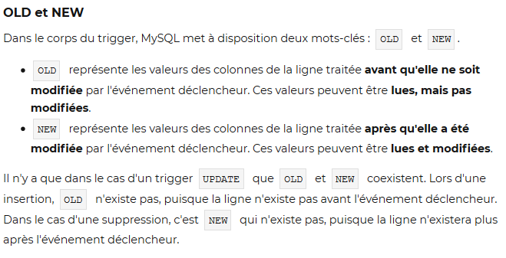

Slide 10
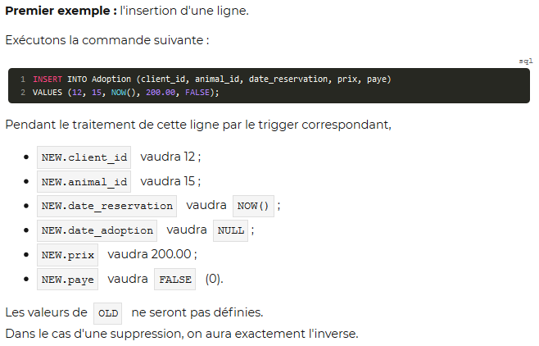

Slide 11
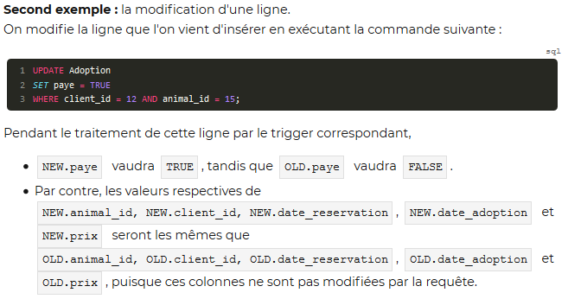

Slide 12
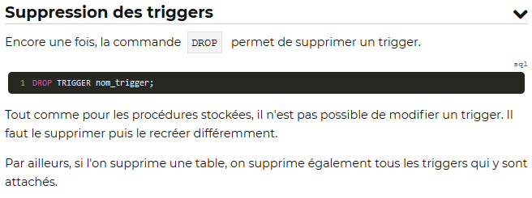

Slide 13
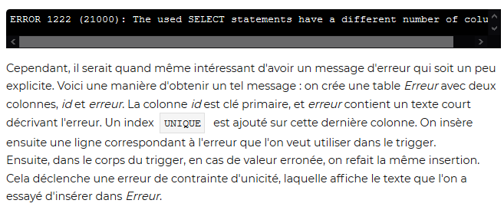
GESTION DES ERREURS

Slide 14
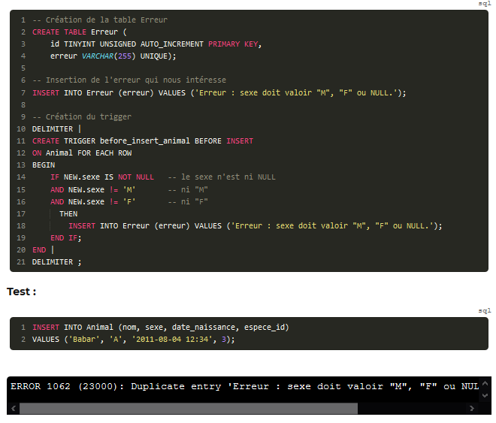
EXEMPLE – GESTION ERREUR

Slide 15
Exemples trigger INSERT, DELETE
CREATE TRIGGER TriDelQualif
AFTER DELETE ON Qualifications
FOR EACH ROW
BEGIN
UPDATE Pilote SET nbQualif = nbQualif-1
WHERE brevet = OLD.brevet
END;
DELETE FROM Qualifications WHERE typa = ‘A320’;
CREATE TRIGGER TriInsQualif
AFTER INSERT ON Qualifications
FOR EACH ROW
BEGIN
UPDATE Pilote SET nbQualif = nbQualif+1
WHERE brevet = NEW.brevet
END;
INSERT INTO Qualifications
VALUES (‘PL-2’, ‘A380’, SYSDATE());

Slide 16
Exemples trigger UPDATE
CREATE TRIGGER TriUpQualif
AFTER UPDATE ON Qualifications
FOR EACH ROW
BEGIN
UPDATE Pilote SET nbQualif = nbQualif-1
WHERE brevet = OLD.brevet
UPDATE Pilote SET nbQualif = nbQualif+1
WHERE brevet = NEW.brevet
END;
UPDATE Qualifications
SET brevet = ‘PL-2’
WHERE brevet = ‘PL-3’
AND typa = ‘A330’ ;

Slide 17
